Slide 1
S.P.E.A.R
Soft Pneumatic EMG Assisted Rehabilitation

Slide 2
Aim
SPEAR is an Active Ankle-Foot Orthosis (AFO), aimed at providing a cheap and affordable solution for rehabilitating stroke survivors.

Slide 3
Abstract
Stroke patients often suffer from Foot Drop, a paralysis of the muscles in the anterior portion of the lower leg, causing an inability or impaired ability to raise the foot from the ankle. This leads to extremities of the foot dragging along the ground while walking, and can cause tripping and other accidents. Presently, patients are trained to walk with canes, and physiotherapy is also prescribed. The physiotherapy requires the presence of a trainer, and these frequent consultations lead to huge expenditure.
Currently, robotic therapeutic tools exist, but the rigidity does not lend itself to the compliant nature of the body, and are unwieldy. They are bulky and heavy which makes them unwearable under regular usage.
As a bio-inspired solution, SPEAR aims to provide a soft robotic approach to the physio therapy. The end effectors at the ankle are a set of soft pneumatic actuators, controlled by electromyography signals (EMG). This achieves a reduction of weight at the joint, and can be custom made to fit the patient’s needs.
Keywords — Rehabilitative robotics, stroke, foot drop, Soft robotics, soft pneumatic actuators, Electromyography

Slide 4
Application
Ease of physiotherapy for those affected with stroke. Physiotherapy is a costly and continuous process, whereas a robotic solution would be a one-time investment. Because of its compliant nature, SPEAR is lighter, smaller and easier to use, contrary to traditional rigid approaches.

Slide 5
COMPONENTS / PART | Role / Functionality.
Thermoplastic Polyurethane, Nylon Mesh | Fabricate the pneumatic actuator
Air compressor | To compress the air from atmosphere and transfer the compressed air to pneumatic actuators
Solenoid Valve | To control the air flow to pneumatic actuators
MCU | To control the solenoid valve from the data obtained from the corresponding EMG sensors
Electromyographic (EMG) sensor | To measure the electrical activity of muscles

Slide 6
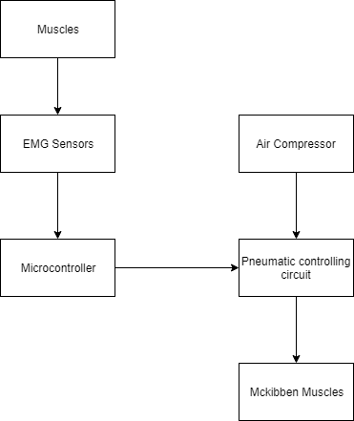
Block Diagram

Slide 7
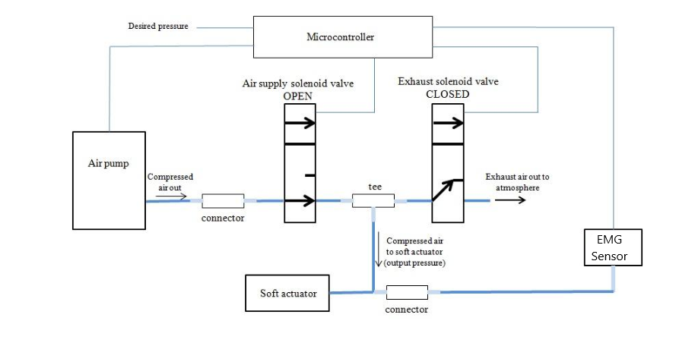

Slide 8
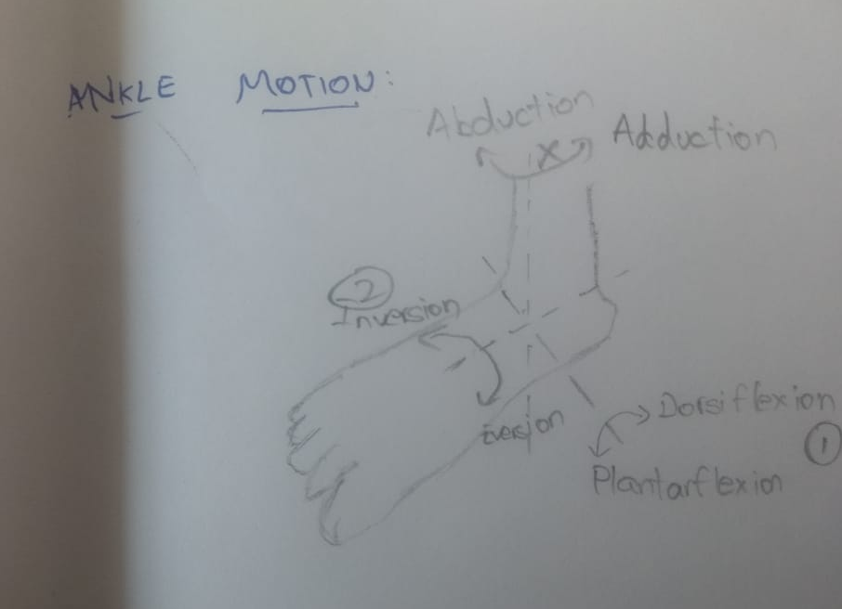
Ankle Motion

Slide 9
McKibben Muscles (Soft artificial muscles)
McKibben Muscles have been fabricated.
The price of a readymade McKibben muscle is minimum Rs.1500
Using off-the shelf components, cost has been reduced to an average Rs.150, depending on Muscle size, diameter
Component | Cost(Rs.)
Bladder(Silicon Rubber) | 40 - 60
Nylon Mesh Sleeve | 40 - 60
Miscellaneous (Connectors, Seals) | 50
Total | 150

Slide 10
Testing Results
Inner Diameter (inch) | Outer Diameter (inch) | Length (cm) | Slack in Nylon Weave | Contraction (cm) | Percentage Contraction
1/3 | 1/2 | 20 | No | 2.5 | 12.5
1/3 | 1/2 | 20 | Yes | 0.5 | 2.5
1/2 | 5/8 | 30 | No | 3 | 10

Slide 11
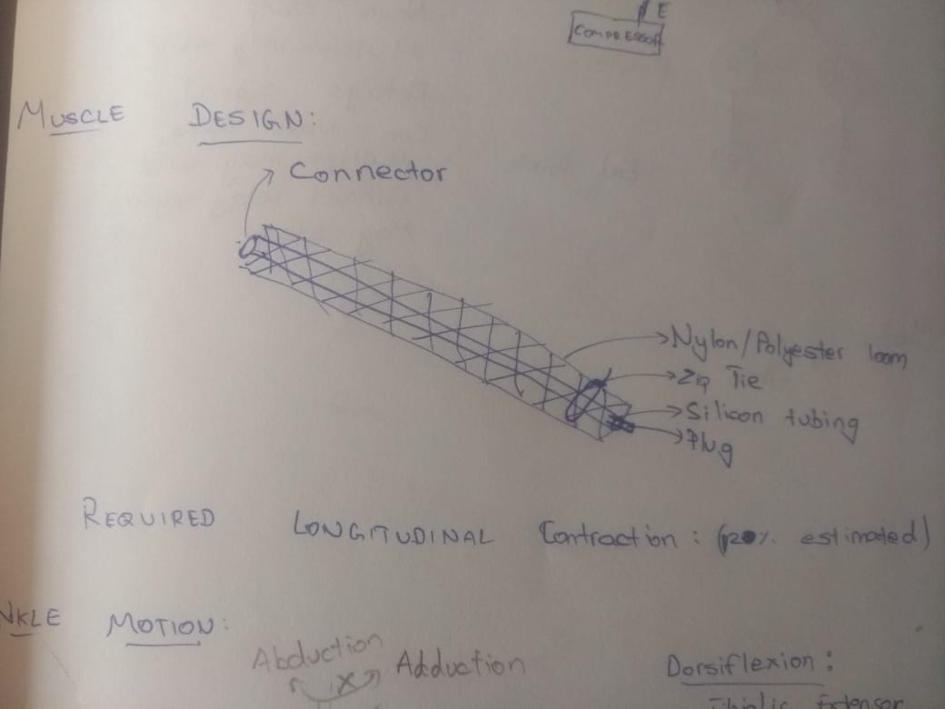
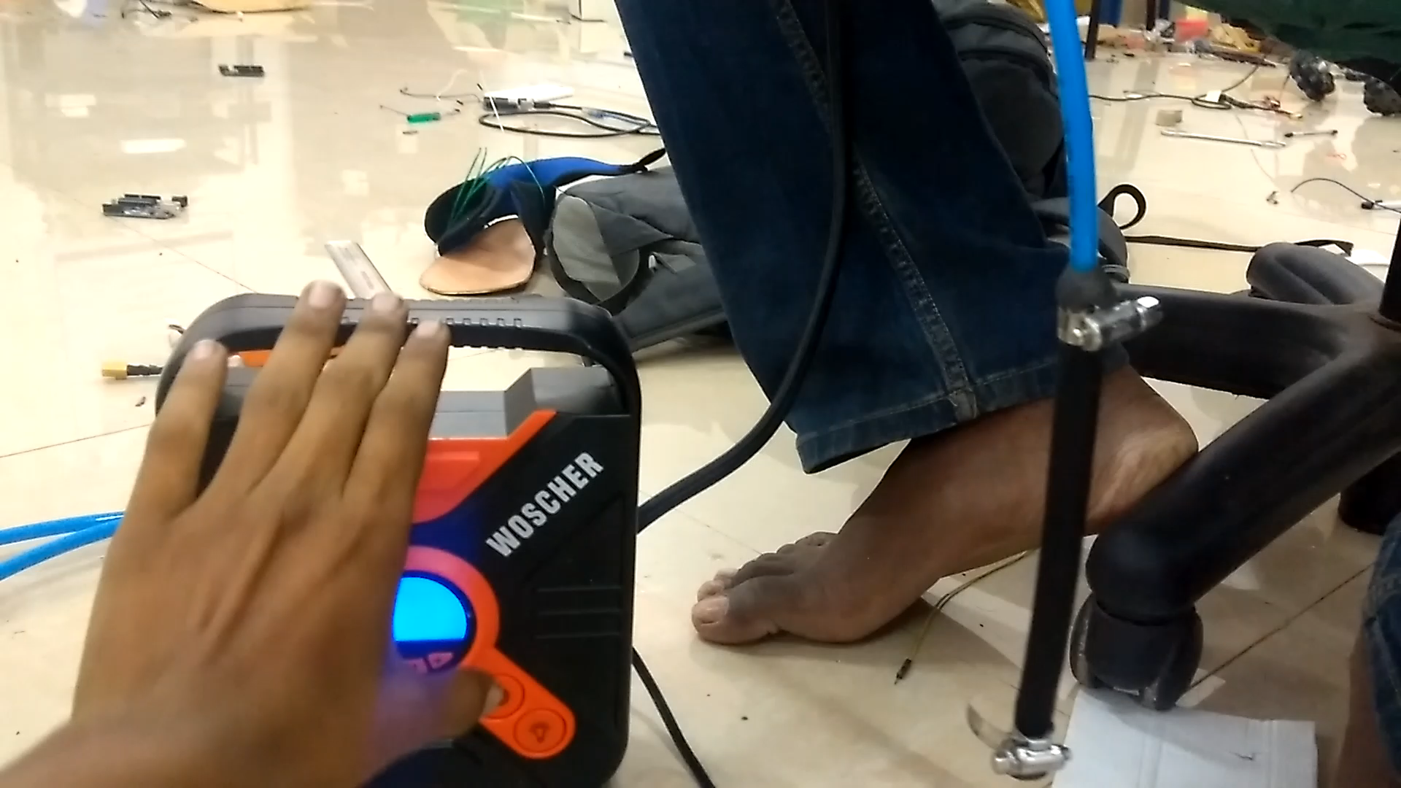
Muscle Test (Video)

Slide 12
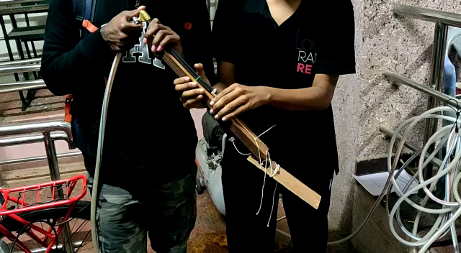
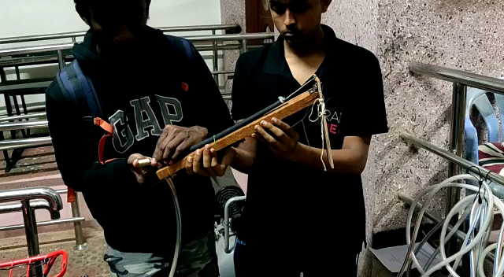
Prototype (120˚ range of motion)
Dorsiflexion
Plantarflexion

Slide 13
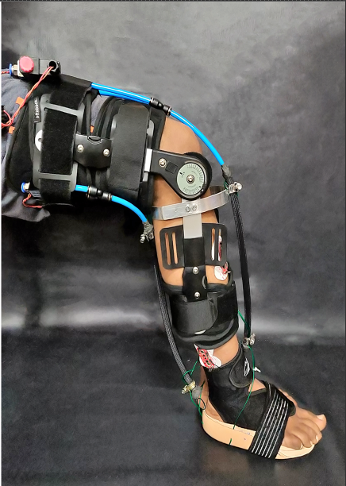
Orthosis Design

Slide 14

EMG Dynamic Thresholding (Video)
Tibialis Anterior for Dorsiflexion

Slide 15
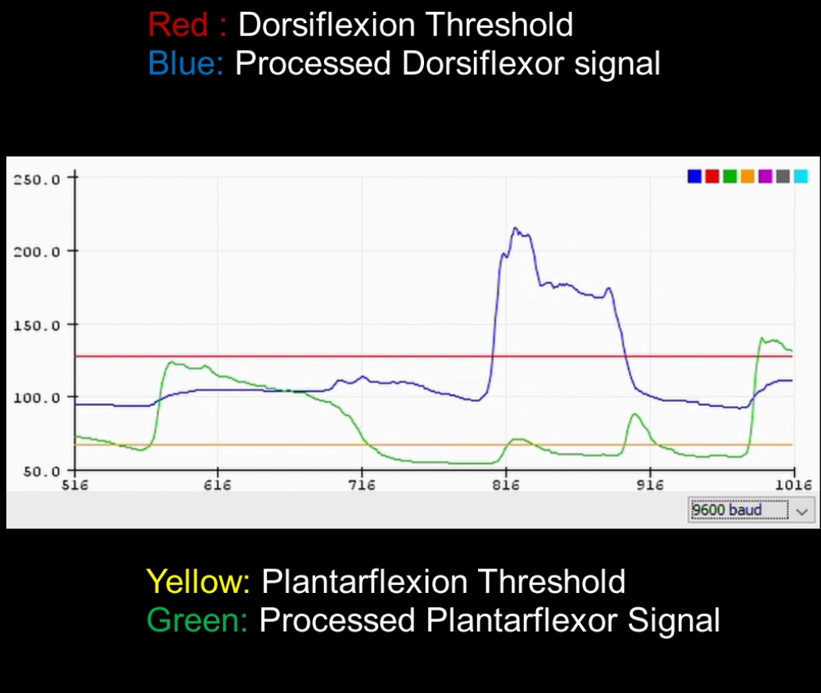
EMG Voltage-Time Graph
Figure shows the voltage time graph obtained after the application of the Kalman Filter to both signals, and the threshold lines calculated using the above formula.

Slide 16
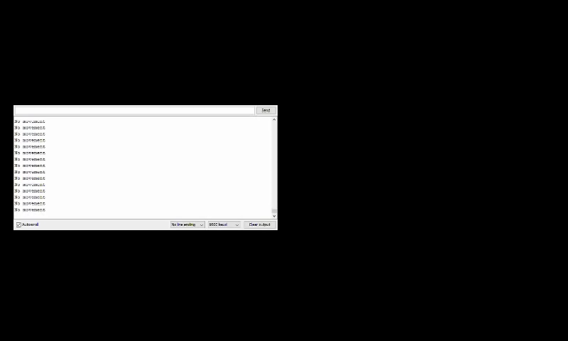
EMG Intent Estimation (Video)

Slide 17
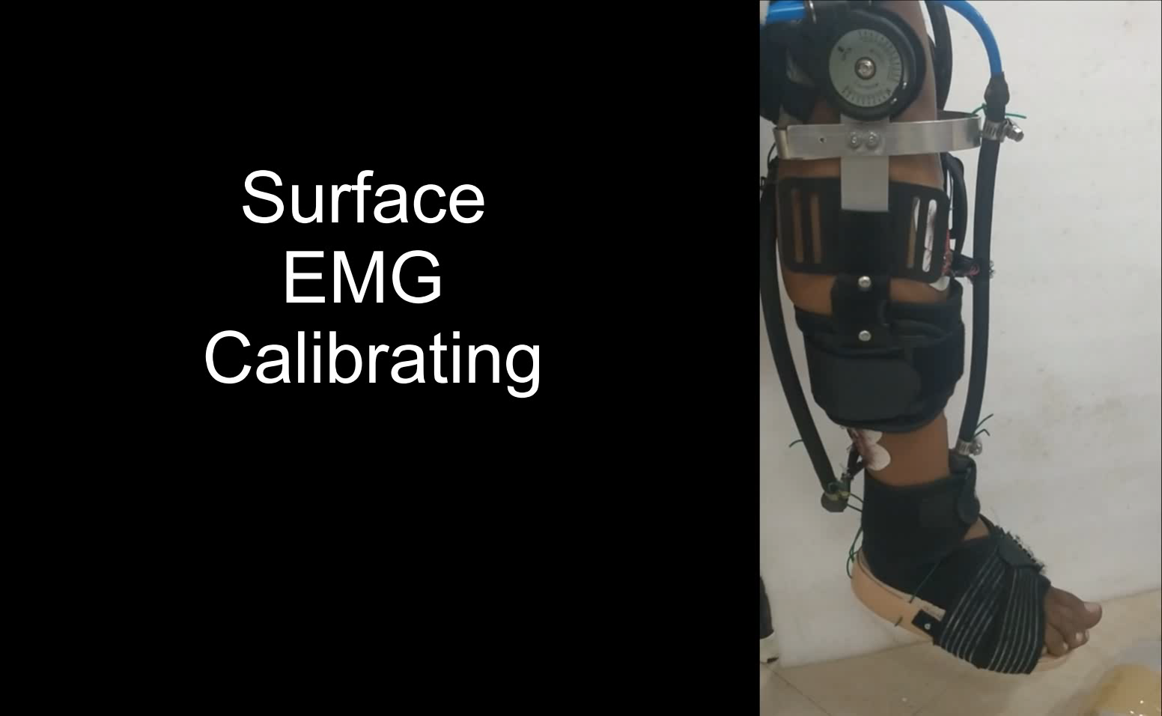
Working Video

Slide 18
Future Work
The Orthosis can be extended to Inversion and Eversion motion in the ankle.
The Orthosis which has primarily been optimised for rehabilitation can be upgraded to Exoskeleton for the lower limb.
Expandability is present for machine learning algorithms for greater accuracy of EMG intent estimation.
The main features of this exoskeleton:
1. Soft McKibben muscles provide actuation, eliminating rigidity and preventing damage to the user
2. Autonomous control of the Lower limb with Electromyography signals.

